Slide 1



BMS
Institute of Technology and Management
Module – 4
Principle of inclusion and exclusion 18CS36
By,
Dr. Pushpa S. K
Professor
Dept. of Information Science & Engg.
BMS Institute of Technology & Mgmt. Bengaluru.
Department of Information Science & Engineering

Slide 2
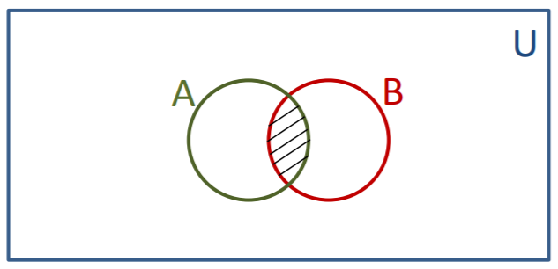
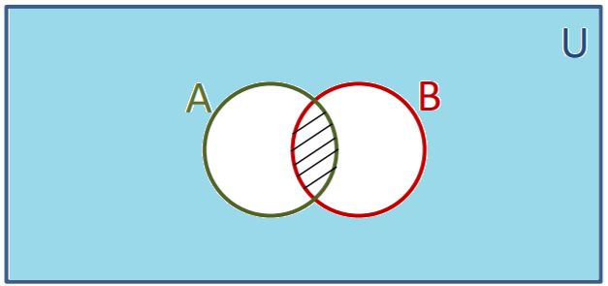
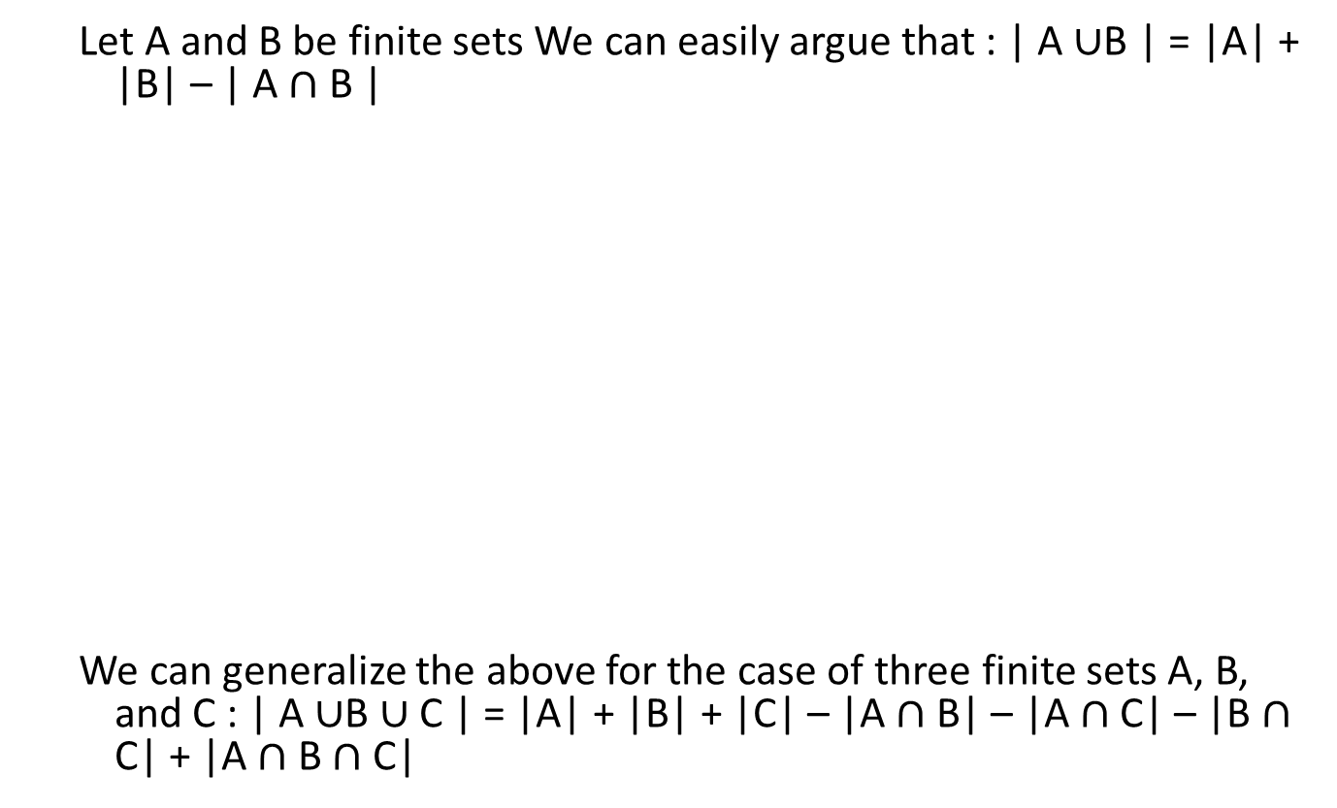
Principle of Inclusion-Exclusion
Let A and B be finite sets We can easily argue that : | A $∪$B | = |A| + |B| – | A $∩$ B |
We can generalize the above for the case of three finite sets A, B, and C : | A $∪$B $∪$C | = |A| + |B| + |C| – |A $∩$ B| – |A $∩$ C| – |B $∩$ C| + |A $∩$ B $∩$ C|

Slide 3
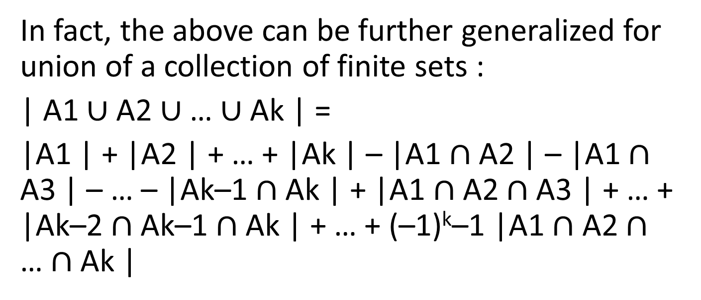
In fact, the above can be further generalized for union of a collection of finite sets :
| A1 $∪$A2 $∪$ … $∪$Ak | =
|A1 | + |A2 | + … + |Ak | – |A1 $∩$ A2 | – |A1 $∩$ A3 | – … – |Ak–1 $∩$Ak | + |A1 $∩$ A2 $∩$ A3 | + … + |Ak–2 $∩$Ak–1 $∩$Ak | + … + (–1)^{k}–1 |A1 $∩$ A2 $∩$ … $∩$Ak |

Slide 4
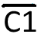
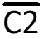
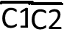
Let C1 and C2 be conditions
N(C1) = # of elements satisfying C1
N(C2) = # of elements satisfying C2
N( ) = # of elements not satisfying C1
N( ) = # of elements not satisfying C2
N( ) = # not C1 and not C2
N( ) = # not C1 or not C2

Slide 5
More General Defn.
N( ) = N – N(C1)
N( ) = N – N(C1) – N(C2) + N(C1C2)
= N – N(C1) – N(C2) - N(C3)+ N(C1C2) + N(C1C3) + N(C2C3) – N(C1C2C3)
Consider a set S with |S| = N, and conditions Ci = 1<=i<=t
= N –[N(C1) + N(C2) + N(C3)+ . . . N(Ct)] + [N(C1C2) + N(C1C3) + N(C2C3)+ . . .
N(Ct-1 Ct)] – [ N(C1C2C3) + . . . + N(Ct-2, Ct-1, Ct)] + . . . . .
(-1)t [N(C1 C2 . . .Ct)]
C1

Slide 6
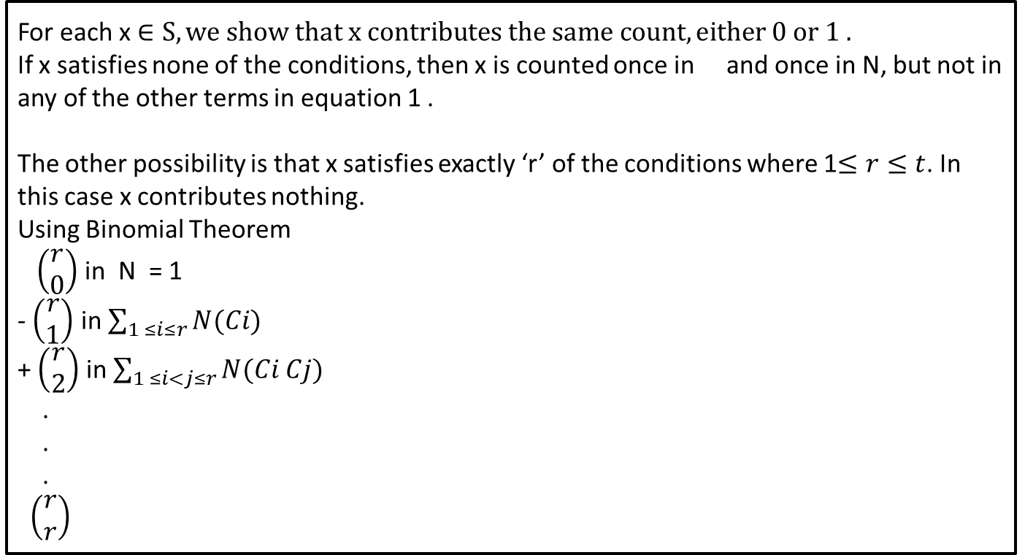
How many times is ‘x’ counted in ‘S’
For each x $∈S, we show that x contributes the same count, either 0 or 1 .$
If x satisfies none of the conditions, then x is counted once in and once in N, but not in any of the other terms in equation 1 .
The other possibility is that x satisfies exactly ‘r’ of the conditions where 1$≤r≤t$. In this case x contributes nothing.
Using Binomial Theorem
$\left(\begin{aligned}r \\ 0\end{aligned}\right)$ in N = 1
- $\left(\begin{aligned}r \\ 1\end{aligned}\right)$ in $\sum_{1 ≤i≤r}{N(Ci)}$
+ $\left(\begin{aligned}r \\ 2\end{aligned}\right)$ in $\sum_{1 ≤i<j≤r}{N(Ci Cj)}$
.
.
.
$\left(\begin{aligned}r \\ r\end{aligned}\right)$

Slide 7
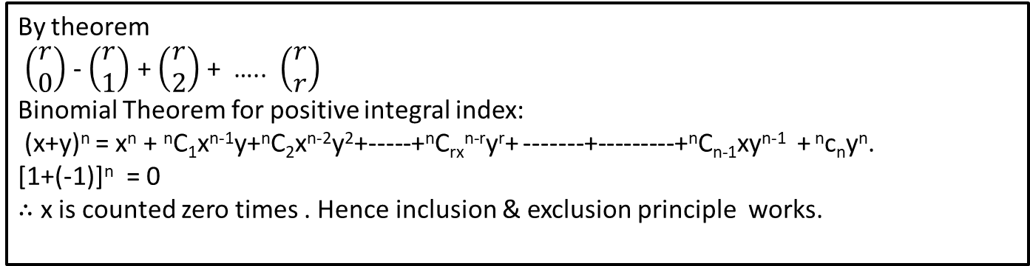
How many times is ‘x’ counted in ‘S’
By theorem
$\left(\begin{aligned}r \\ 0\end{aligned}\right)$ - $\left(\begin{aligned}r \\ 1\end{aligned}\right)$ + $\left(\begin{aligned}r \\ 2\end{aligned}\right)$+ ….. $\left(\begin{aligned}r \\ r\end{aligned}\right)$
Binomial Theorem for positive integral index:
(x+y)^{n} = x^{n} + ^{n}C₁x^{n-1}y+^{n}C₂x^{n-2}y²+-----+^{n}C_{rx}^{n-r}y^{r}+ -------+---------+^{n}C_{n-1}xy^{n-1} + ^{n}c_{n}y^{n}.
[1+(-1)]^{n} = 0
$∴$ x is counted zero times . Hence inclusion & exclusion principle works.

Slide 8
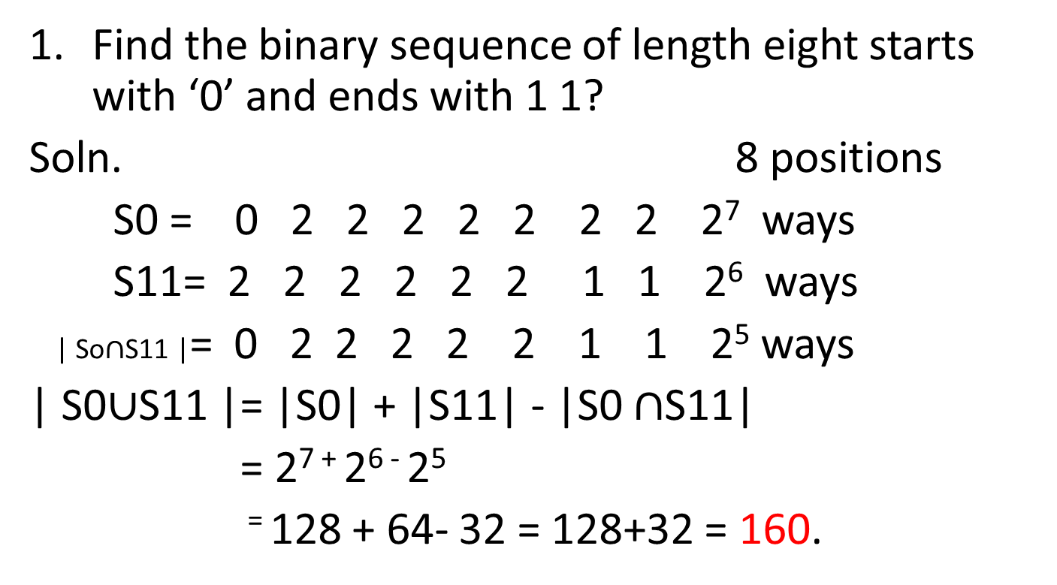
Problems
Find the binary sequence of length eight starts with ‘0’ and ends with 1 1?
Soln. 8 positions
S0 = 0 2 2 2 2 2 2 2 2⁷ ways
S11= 2 2 2 2 2 2 1 1 2⁶ ways
| So$∩$S11 |= 0 2 2 2 2 2 1 1 2⁵ ways
| S0$∪$S11 |= |S0| + |S11| - |S0 $∩$S11|
= 2⁷ ⁺ 2⁶ ⁻ 2⁵
⁼ 128 + 64- 32 = 128+32 = 160.

Slide 9
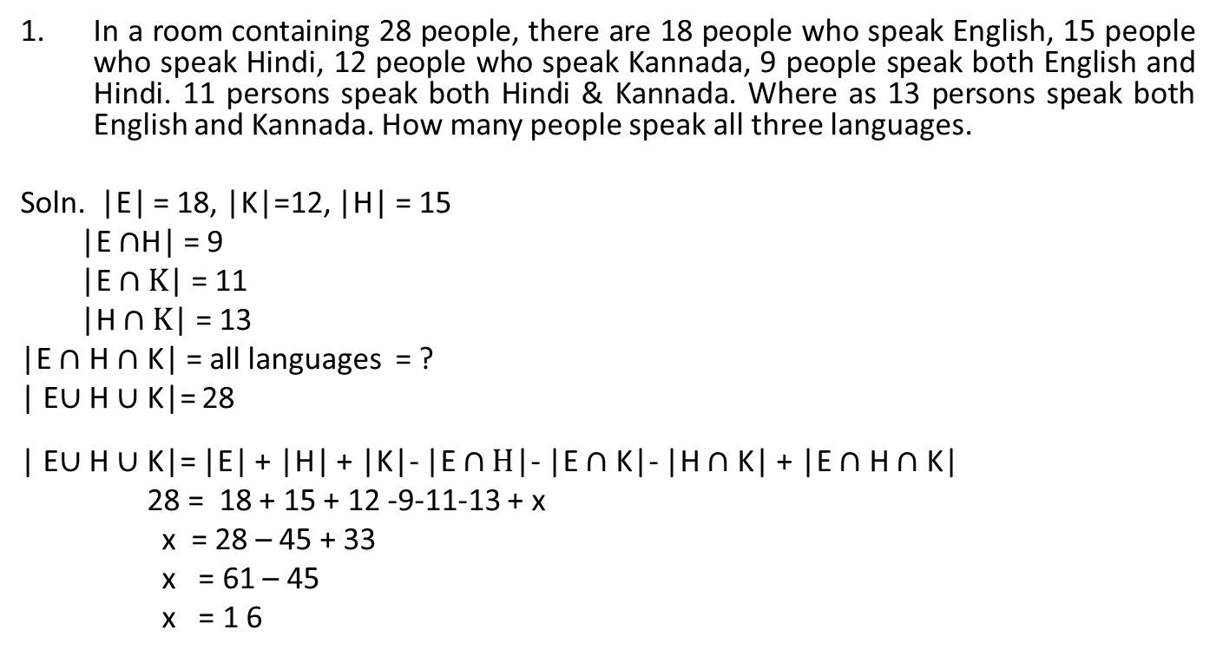
Problems
In a room containing 28 people, there are 18 people who speak English, 15 people who speak Hindi, 12 people who speak Kannada, 9 people speak both English and Hindi. 11 persons speak both Hindi & Kannada. Where as 13 persons speak both English and Kannada. How many people speak all three languages.
Soln. |E| = 18, |K|=12, |H| = 15
|E $∩$H| = 9
|E $∩K$| = 11
|H $∩K$| = 13
|E $∩$ H $∩$ K| = all languages = ?
| E$∪$ H $∪$ K|= 28
| E$∪$ H $∪$ K|= |E| + |H| + |K|- |E $∩H$|- |E $∩$ K|- |H $∩$ K| + |E $∩$H $∩$K|
28 = 18 + 15 + 12 -9-11-13 + x
x = 28 – 45 + 33
x = 61 – 45
x = 1 6

Slide 10
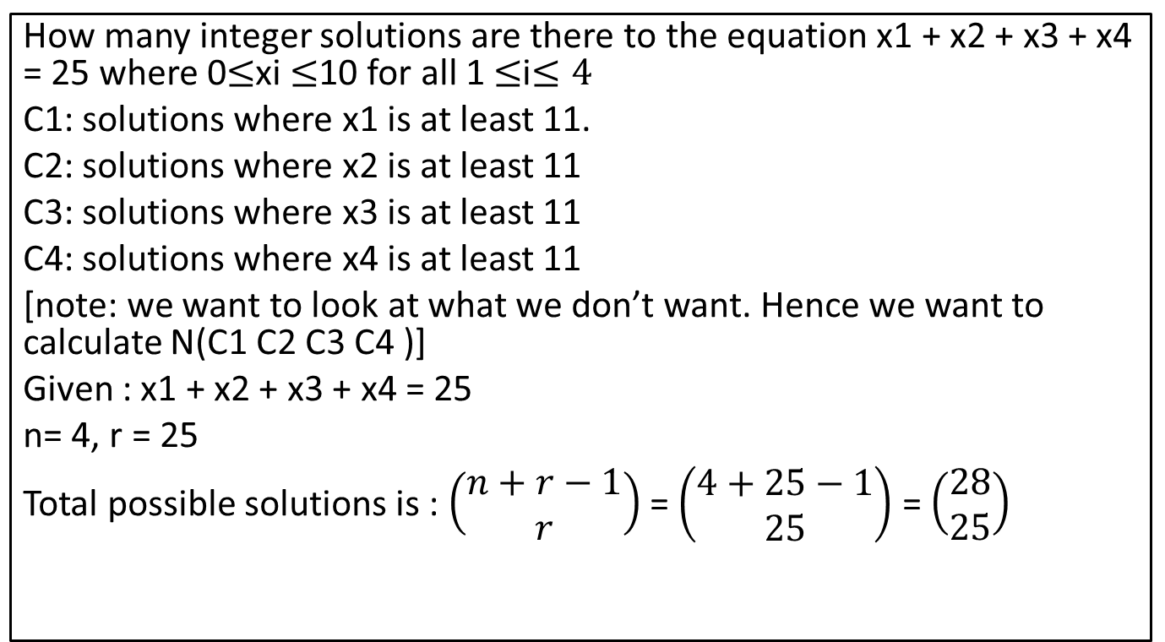
Problem
How many integer solutions are there to the equation x1 + x2 + x3 + x4 = 25 where 0$≤$xi $≤$10 for all 1 $≤$i$≤4$
C1: solutions where x1 is at least 11.
C2: solutions where x2 is at least 11
C3: solutions where x3 is at least 11
C4: solutions where x4 is at least 11
[note: we want to look at what we don’t want. Hence we want to calculate N(C1 C2 C3 C4 )]
Given : x1 + x2 + x3 + x4 = 25
n= 4, r = 25
Total possible solutions is : $\left(\begin{aligned}n+r−1 \\ r\end{aligned}\right)$ = $\left(\begin{aligned}4+25−1 \\ 25\end{aligned}\right)$ = $\left(\begin{aligned}28 \\ 25\end{aligned}\right)$

Slide 11
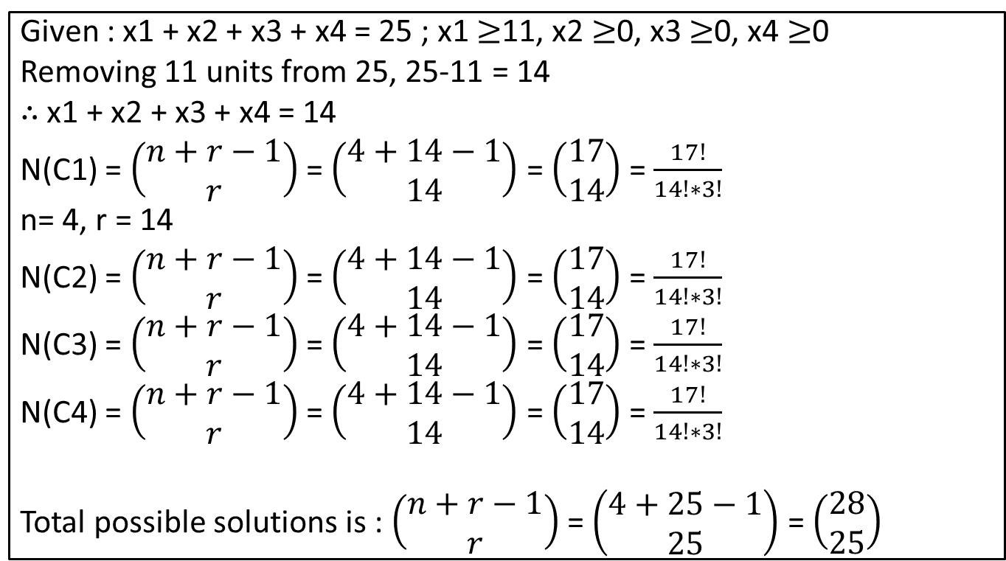
Problem
Given : x1 + x2 + x3 + x4 = 25 ; x1 $≥$11, x2$≥$0, x3$≥$0, x4$≥$0
Removing 11 units from 25, 25-11 = 14
$∴$ x1 + x2 + x3 + x4 = 14
N(C1) = $\left(\begin{aligned}n+r−1 \\ r\end{aligned}\right)$= $\left(\begin{aligned}4+14−1 \\ 14\end{aligned}\right)$= $\left(\begin{aligned}17 \\ 14\end{aligned}\right)$= $\frac{17!}{14!∗3!}$
n= 4, r = 14
N(C2) = $\left(\begin{aligned}n+r−1 \\ r\end{aligned}\right)$ = $\left(\begin{aligned}4+14−1 \\ 14\end{aligned}\right)$ = $\left(\begin{aligned}17 \\ 14\end{aligned}\right)$ = $\frac{17!}{14!∗3!}$
N(C3) = $\left(\begin{aligned}n+r−1 \\ r\end{aligned}\right)$ = $\left(\begin{aligned}4+14−1 \\ 14\end{aligned}\right)$ = $\left(\begin{aligned}17 \\ 14\end{aligned}\right)$ = $\frac{17!}{14!∗3!}$
N(C4) = $\left(\begin{aligned}n+r−1 \\ r\end{aligned}\right)$ = $\left(\begin{aligned}4+14−1 \\ 14\end{aligned}\right)$ = $\left(\begin{aligned}17 \\ 14\end{aligned}\right)$ = $\frac{17!}{14!∗3!}$
Total possible solutions is : $\left(\begin{aligned}n+r−1 \\ r\end{aligned}\right)$ = $\left(\begin{aligned}4+25−1 \\ 25\end{aligned}\right)$ = $\left(\begin{aligned}28 \\ 25\end{aligned}\right)$

Slide 12
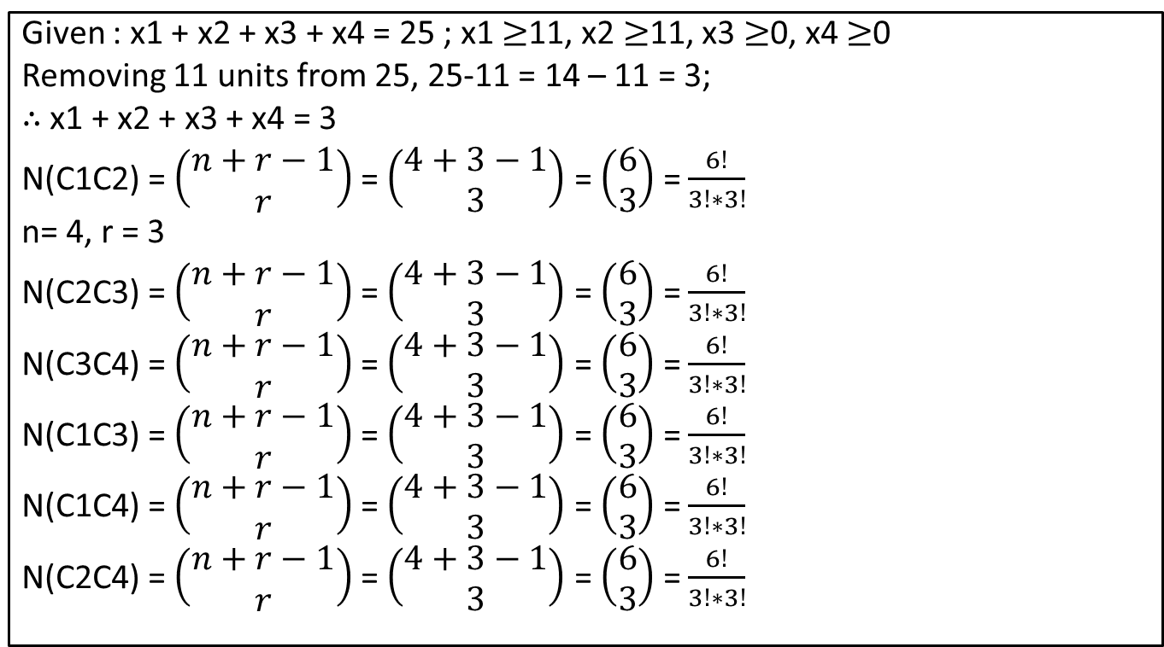
Problem
Given : x1 + x2 + x3 + x4 = 25 ; x1 $≥$11, x2$≥$11, x3$≥$0, x4$≥$0
Removing 11 units from 25, 25-11 = 14 – 11 = 3;
$∴$ x1 + x2 + x3 + x4 = 3
N(C1C2) = $\left(\begin{aligned}n+r−1 \\ r\end{aligned}\right)$= $\left(\begin{aligned}4+3−1 \\ 3\end{aligned}\right)$= $\left(\begin{aligned}6 \\ 3\end{aligned}\right)$= $\frac{6!}{3!∗3!}$
n= 4, r = 3
N(C2C3) = $\left(\begin{aligned}n+r−1 \\ r\end{aligned}\right)$ = $\left(\begin{aligned}4+3−1 \\ 3\end{aligned}\right)$ = $\left(\begin{aligned}6 \\ 3\end{aligned}\right)$ = $\frac{6!}{3!∗3!}$
N(C3C4) = $\left(\begin{aligned}n+r−1 \\ r\end{aligned}\right)$ = $\left(\begin{aligned}4+3−1 \\ 3\end{aligned}\right)$ = $\left(\begin{aligned}6 \\ 3\end{aligned}\right)$ = $\frac{6!}{3!∗3!}$
N(C1C3) = $\left(\begin{aligned}n+r−1 \\ r\end{aligned}\right)$ = $\left(\begin{aligned}4+3−1 \\ 3\end{aligned}\right)$ = $\left(\begin{aligned}6 \\ 3\end{aligned}\right)$ = $\frac{6!}{3!∗3!}$
N(C1C4) = $\left(\begin{aligned}n+r−1 \\ r\end{aligned}\right)$ = $\left(\begin{aligned}4+3−1 \\ 3\end{aligned}\right)$ = $\left(\begin{aligned}6 \\ 3\end{aligned}\right)$ = $\frac{6!}{3!∗3!}$
N(C2C4) = $\left(\begin{aligned}n+r−1 \\ r\end{aligned}\right)$ = $\left(\begin{aligned}4+3−1 \\ 3\end{aligned}\right)$ = $\left(\begin{aligned}6 \\ 3\end{aligned}\right)$ = $\frac{6!}{3!∗3!}$

Slide 13
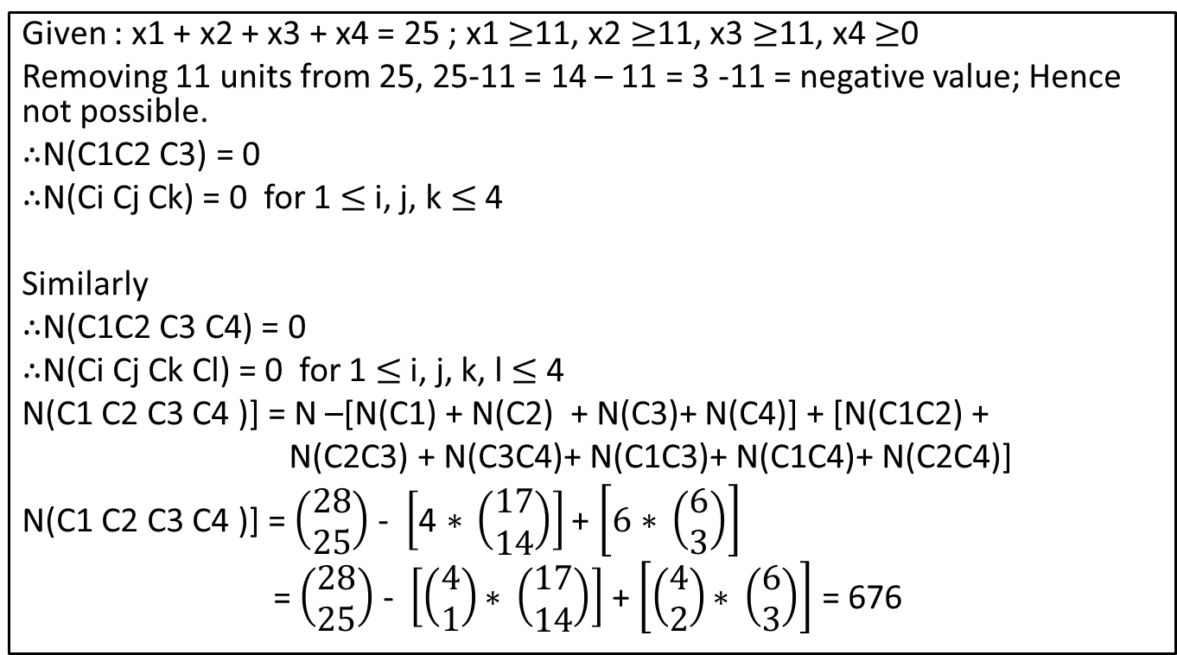
Problem
Given : x1 + x2 + x3 + x4 = 25 ; x1 $≥$11, x2$≥$11, x3$≥$11, x4$≥$0
Removing 11 units from 25, 25-11 = 14 – 11 = 3 -11 = negative value; Hence not possible.
$∴$N(C1C2 C3) = 0
$∴$N(Ci Cj Ck) = 0 for 1 $≤$i, j, k $≤$ 4
Similarly
$∴$N(C1C2 C3 C4) = 0
$∴$N(Ci CjCkCl) = 0 for 1 $≤$ i, j, k, l $≤$4
N(C1 C2 C3 C4 )] = N –[N(C1) + N(C2) + N(C3)+ N(C4)] + [N(C1C2) +
N(C2C3) + N(C3C4)+ N(C1C3)+N(C1C4)+N(C2C4)]
N(C1 C2 C3 C4 )] = $\left(\begin{aligned}28 \\ 25\end{aligned}\right)$- $\left[\text{4 ∗ }\left(\begin{aligned}17 \\ 14\end{aligned}\right)\right]$ + $\left[\text{6}\text{ ∗ }\left(\begin{aligned}6 \\ 3\end{aligned}\right)\right]$
= $\left(\begin{aligned}28 \\ 25\end{aligned}\right)$ - $\left[\left(\begin{aligned}4 \\ 1\end{aligned}\right)\text{∗ }\left(\begin{aligned}17 \\ 14\end{aligned}\right)\right]$ + $\left[\left(\begin{aligned}4 \\ 2\end{aligned}\right)\text{∗ }\left(\begin{aligned}6 \\ 3\end{aligned}\right)\right]$= 676

Slide 14
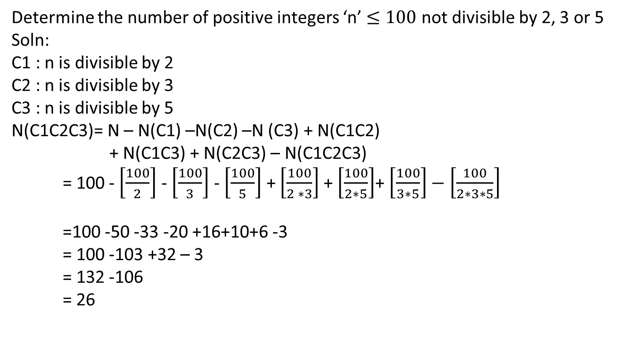
Problem
Determine the number of positive integers ‘n’ $≤100$ not divisible by 2, 3 or 5
Soln:
C1 : n is divisible by 2
C2 : n is divisible by 3
C3 : n is divisible by 5
N(C1C2C3)= N – N(C1) –N(C2) –N (C3) + N(C1C2)
+ N(C1C3) + N(C2C3) – N(C1C2C3)
= 100 - $\left[\frac{100}{2}\right]$ -$\left[\frac{100}{3}\right]$- $\left[\frac{100}{5}\right]$+ $\left[\frac{100}{2 ∗3}\right]$+$\left[\frac{100}{2∗5}\right]$+$\left[\frac{100}{3∗5}\right]−\left[\frac{100}{2∗3∗5}\right]$
=100 -50 -33 -20 +16+10+6 -3
= 100 -103 +32 – 3
= 132 -106
= 26

Slide 15
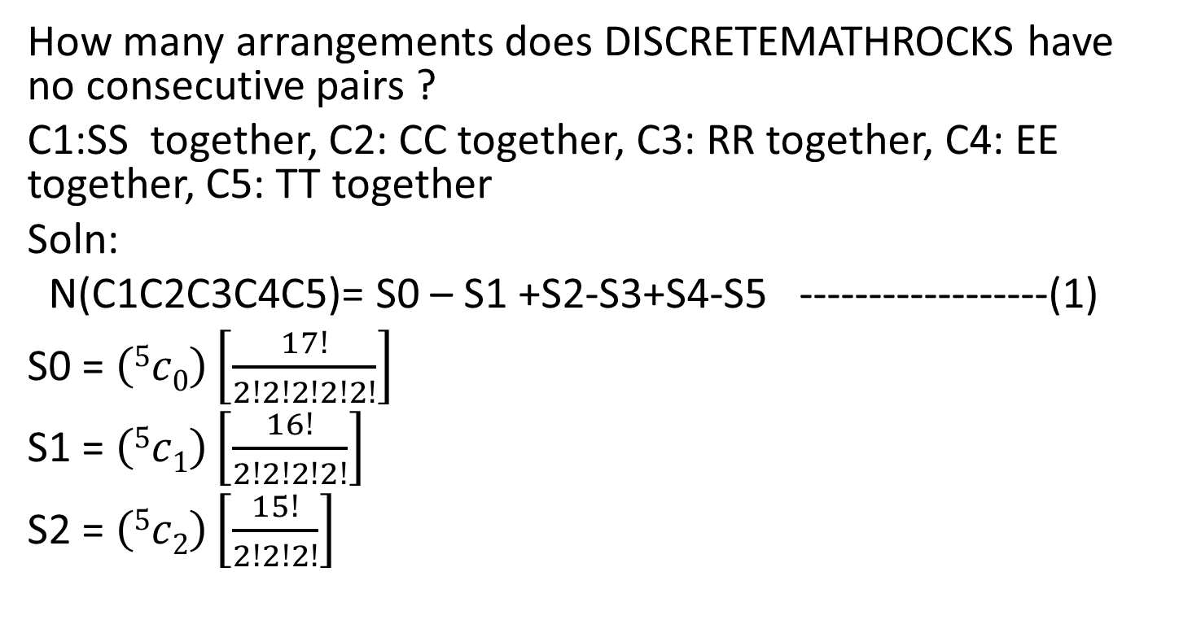
Problem
How many arrangements does DISCRETEMATHROCKS have no consecutive pairs ?
C1:SS together, C2: CC together, C3: RR together, C4: EE together, C5: TT together
Soln:
N(C1C2C3C4C5)= S0 – S1 +S2-S3+S4-S5 ------------------(1)
S0 = $\left(5c0\right)\left[\frac{17!}{2!2!2!2!2!}\right]$
S1 = $\left(5c1\right)\left[\frac{16!}{2!2!2!2!}\right]$
S2 = $\left(5c2\right)\left[\frac{15!}{2!2!2!}\right]$

Slide 16
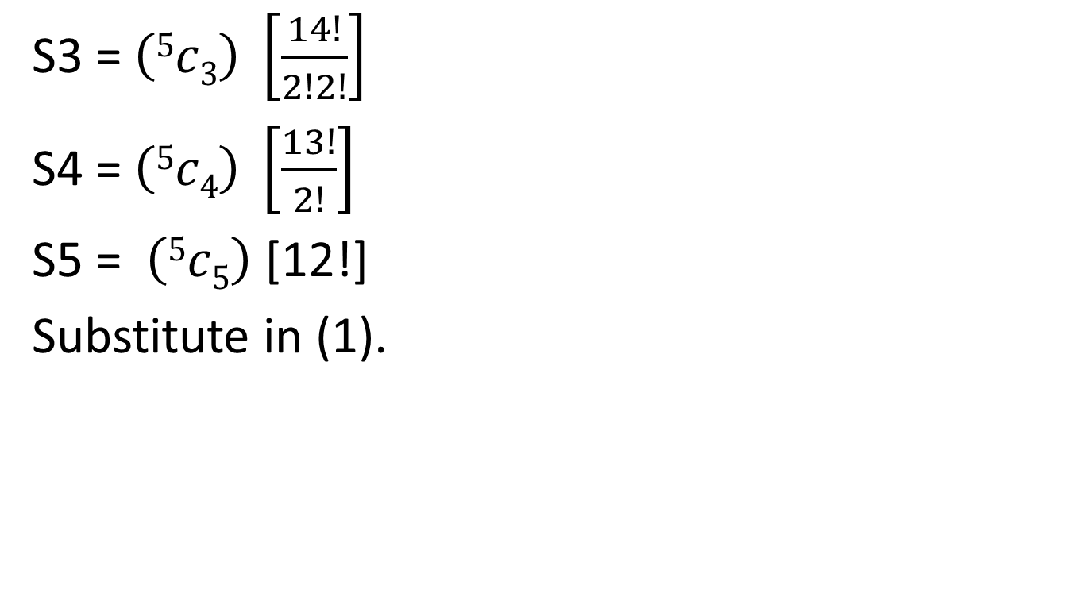
S3 = $\left(5c3\right) \left[\frac{14!}{2!2!}\right]$
S4 = $\left(5c4\right) \left[\frac{13!}{2!}\right]$
S5 = $\left(5c5\right)$[12!]
Substitute in (1).

Slide 17
Problem
In how many ways can the 26 letters of the English alphabet be permuted so that none of the patterns CAR, DOG, PUN or BYTE occurs?
Soln:
Let N : Set of all permutation of the 26 letters = 26!
Let N(C1): But the set of all permutations in which CAR appear.
N(C1) : [26 – 3 + 1]! = 24!
N(C2) : [26 – 3 + 1]! = 24! { DOG – 3 char}
N(C3) : [26 – 3 + 1]! = 24! { PUN – 3 char}
N(C4) : [26 – 4 + 1]! = 23! { BYTE – 4 char}

Slide 18
N(C1C2) : [26 -3-3+1+1]! = 22!
N(C2C3) : [26 -3-3+1+1]! = 22!
N(C1C3) : [26 -3-3+1+1]! = 22!
N(C1C4) : [26 -3-4+1+1]! = 21! = N(C2C4) = N(C3C4)
N(C1C2C3) : [26-3-3-3+1+1+1]! = 20!
N(C1C2C4) : [26-3-3-4+1+1+1]! = 19!
N(C2C3C4) : [26-3-3-4+1+1+1]! = 19!
N(C1C3C4) : [26-3-3-4+1+1+1]! = 19!
N(C1C2C3C4) : [26-3-3-3-4+1+1+1+1]! = 17!

Slide 19
N(C1C2C3C4) = 26! - [3 * 24! + 23!]+[3 * 22! + 3 *
21!] – [ 20! + 3 * 19!] + 17!
=

Slide 20
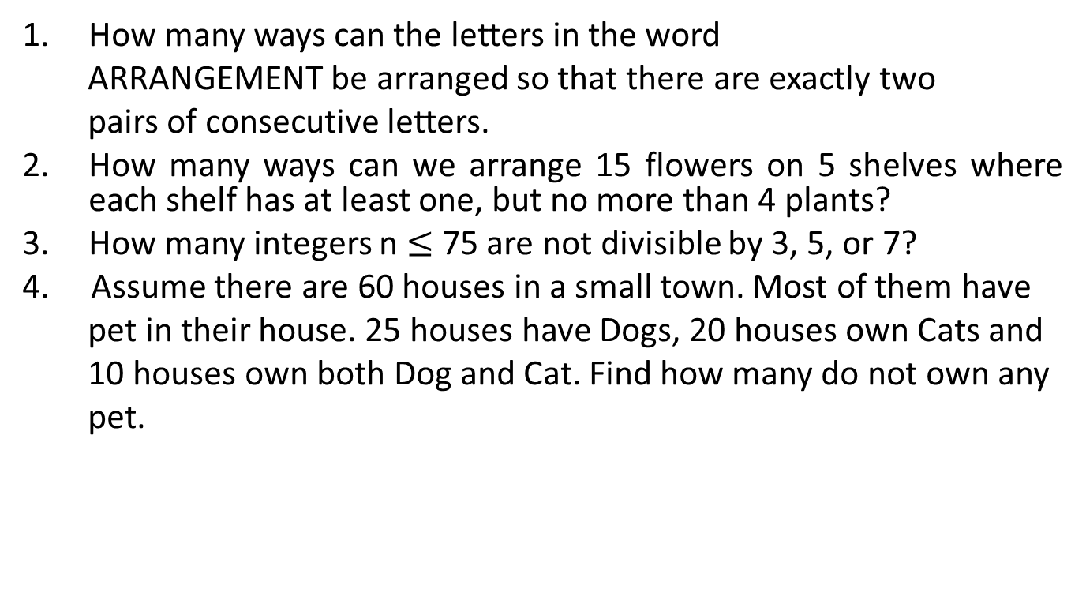
Problems
How many ways can the letters in the word
ARRANGEMENT be arranged so that there are exactly two
pairs of consecutive letters.
How many ways can we arrange 15 flowers on 5 shelves where each shelf has at least one, but no more than 4 plants?
How many integers n $≤$75 are not divisible by 3, 5, or 7?
4. Assume there are 60 houses in a small town. Most of them have
pet in their house. 25 houses have Dogs, 20 houses own Cats and
10 houses own both Dog and Cat. Find how many do not own any
pet.

Slide 21
Thank You

